Slide 1
Regression models
School of Electrical and Computer Engineering
University of Tehran
Erfan Darzi
erfandarzi@ut.ac.ir

Slide 2

Recap: Naïve Bayes classifier
$f\left(X\right)=argmax_{y}P\left(y | X\right)$
$$=argmax_{y}P\left(X | y\right)P(y)$$
$$=argmax_{y}\prod_{i=1}^{V}{P(x_{i}|y)}P\left(y\right)$$
Class conditional density
Class prior
#parameters:
$$\left|Y\right|×V$$
$$\left|Y\right|−1$$
v.s.
$$\left|Y\right|×(2^{V}−1)$$
Computationally feasible

Slide 3
Today’s lecture
Logistic regression model
A discriminative classification model
Two different perspectives to derive the model
Parameter estimation

Slide 4





Review: Bayes risk minimization
Risk – assign instance to a wrong class
$y^{∗}=argmax_{y}P(y|X)$
*Optimal Bayes decision boundary
$$p(X,y)$$
We have learned multiple ways to estimate this
$$\hat{y}=0$$
$$\hat{y}=1$$
$$p\left(X | y=0\right)p(y=0)$$
$$p\left(X | y=1\right)p(y=1)$$
$$X$$
False negative
False positive

Slide 5
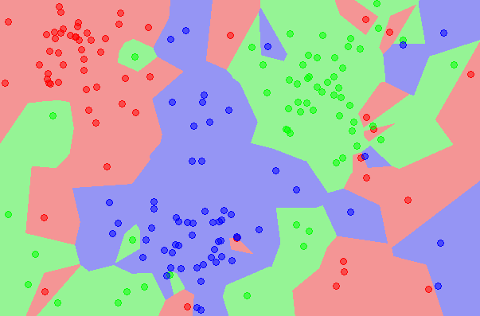
Instance-based solution
k nearest neighbors
Approximate Bayes decision rule in a subset of data around the testing point

Slide 6


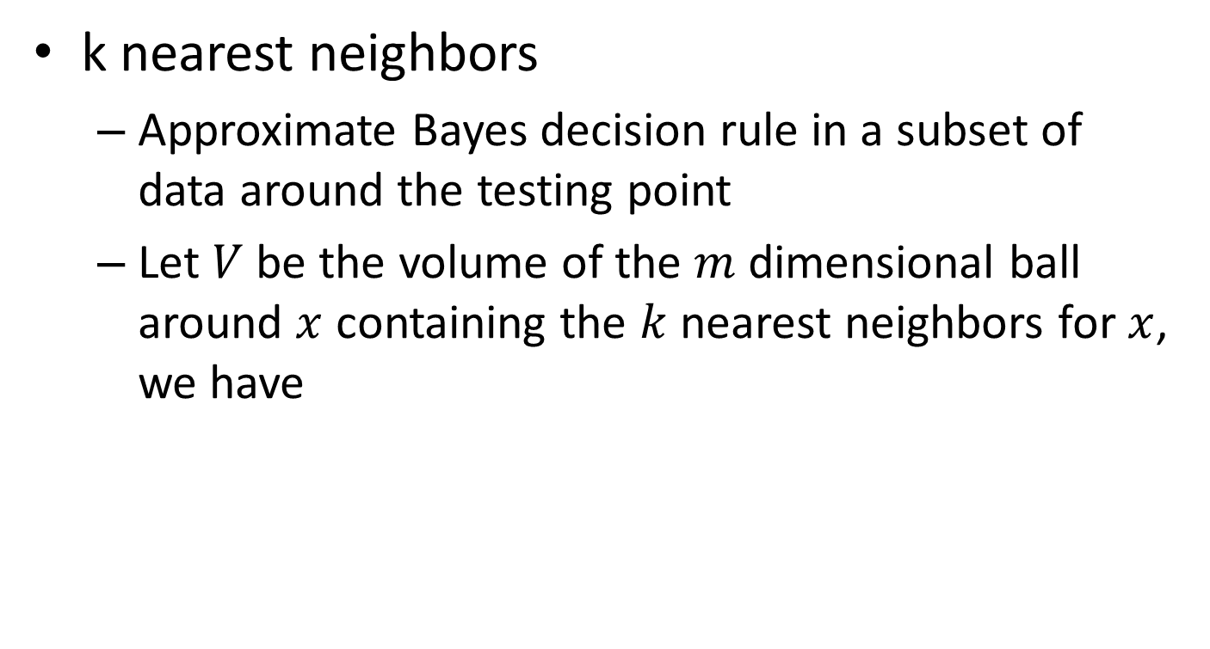



Instance-based solution
k nearest neighbors
Approximate Bayes decision rule in a subset of data around the testing point
Let $V$ be the volume of the $m$ dimensional ball around $x$ containing the $k$ nearest neighbors for $x$, we have
$$p\left(x\right)V=\frac{k}{N}$$
$$p\left(x\right)=\frac{k}{NV}$$
$$p\left(x|y=1\right)=\frac{k_{1}}{N_{1}V}$$
$$p\left(y=1\right)=\frac{N_{1}}{N}$$
=>
Total number of instances
With Bayes rule:
$$p\left(y=1|x\right)=\frac{\frac{N_{1}}{N}×\frac{k_{1}}{N_{1}V}}{\frac{k}{NV}}=\frac{k_{1}}{k}$$
Total number of instances in class 1
Counting the nearest neighbors from class1

Slide 7


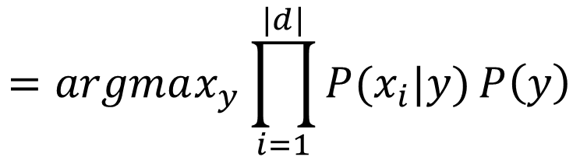
Generative solution
Naïve Bayes classifier
$y^{∗}=argmax_{y}P\left(y | X\right)$
$$=argmax_{y}P\left(X | y\right)P(y)$$
By Bayes rule
$$=argmax_{y}\prod_{i=1}^{|d|}{P(x_{i}|y)}P\left(y\right)$$
By independence assumption
y
x₁
x₂
x₃
…
x_{v}

Slide 8

Estimating parameters
Maximial likelihood estimator
$P\left(x_{i} | y\right)=\frac{\sum_{d}{\sum_{j}{δ(x_{d}^{j}=x_{i},y_{d}=y)}}}{\sum_{d}{δ(y_{d}=y)}}$
$P(y)=\frac{\sum_{d}{δ(y_{d}=y)}}{\sum_{d}{1}}$
 | text | information | identify | mining | mined | is | useful | to | from | apple | delicious | Y
D1 | 1 | 1 | 1 | 1 | 0 | 1 | 1 | 1 | 0 | 0 | 0 | 1
D2 | 1 | 1 | 0 | 0 | 1 | 1 | 1 | 0 | 1 | 0 | 0 | 1
D3 | 0 | 0 | 0 | 0 | 0 | 1 | 0 | 0 | 0 | 1 | 1 | 0

Slide 9
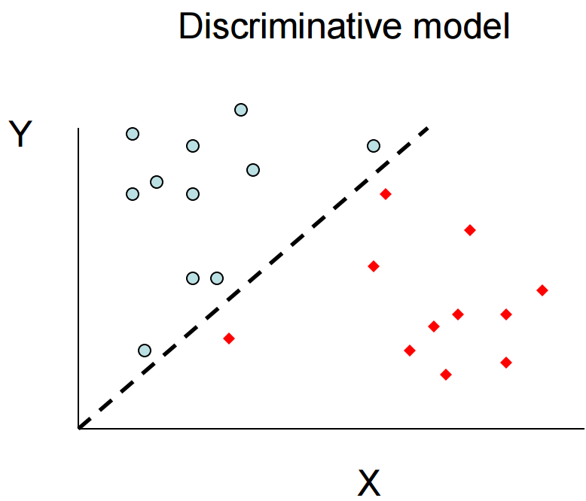
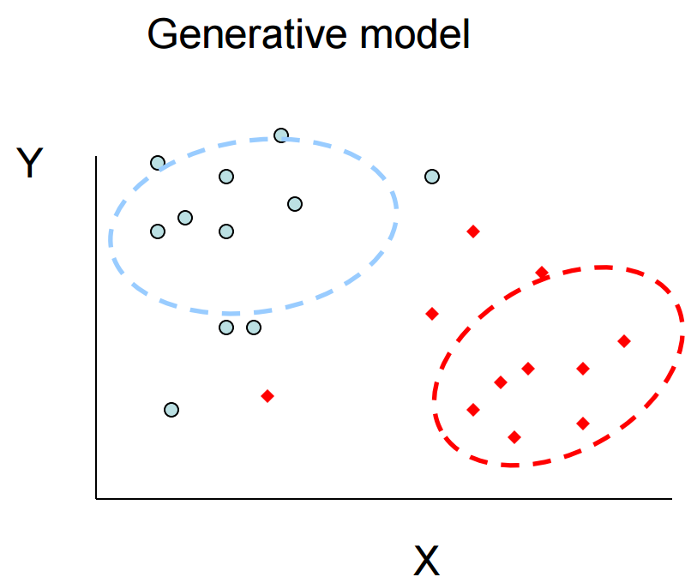

Discriminative v.s. generative models
All instances are considered for probability density estimation
$$y=f(x)$$
More attention will be put onto the boundary points

Slide 10
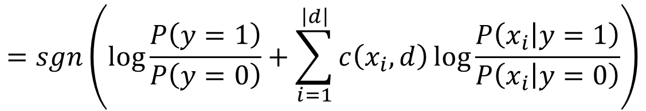


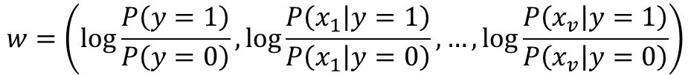

Parametric form of decision boundary in Naïve Bayes
For binary cases
$f\left(X\right)=sgn(\log{P\left(y=1 | X\right)−\log{P(y=0|X))}}$
$$=sgn\left(\log{\frac{P\left(y=1\right)}{P\left(y=0\right)}}+\sum_{i=1}^{\left|d\right|}{c\left(x_{i},d\right)\log{\frac{P\left(x_{i} | y=1\right)}{P\left(x_{i} | y=0\right)}}}\right)$$
$$=sgn(w^{T}\overline{X})$$
where
Linear regression?
$$w=\left(\log{\frac{P\left(y=1\right)}{P\left(y=0\right)}},\log{\frac{P\left(x_{1} | y=1\right)}{P\left(x_{1} | y=0\right)}},…,\log{\frac{P\left(x_{v} | y=1\right)}{P\left(x_{v} | y=0\right)}}\right)$$
$$\overline{X}=(1,c(x_{1},d),…,c(x_{v},d))$$

Slide 11
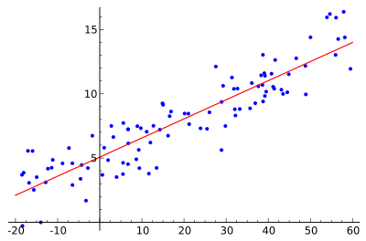

Regression for classification?
Linear regression
$y←w^{T}X$
Relationship between a scalar dependent variable $y$ and one or more explanatory variables

Slide 12
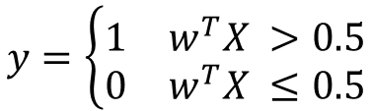
Regression for classification?
Linear regression
$y←w^{T}X$
Relationship between a scalar dependent variable $y$ and one or more explanatory variables
Y is discrete in a classification problem!
y
$$y=\left\{\begin{matrix}1 & w^{T}X >0.5 \\ 0 & w^{T}X ≤0.5\end{matrix}\right.$$
1.00
0.75
What if we have an outlier?
0.50
Optimal regression model
0.25
0.00
x

Slide 13

Regression for classification?
Logistic regression
$p\left(y | x\right)=σ\left(w^{T}X\right)=\frac{1}{1+exp⁡(−w^{T}X)}$
Directly modeling of class posterior
Sigmoid function
P(y|x)
1.00
0.75
What if we have an outlier?
0.50
0.25
0.00
x

Slide 14


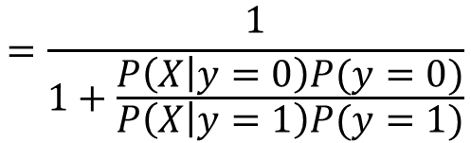


Logistic regression for classification
Why sigmoid function?
$P\left(y=1 | X\right)=\frac{P\left(X | y=1\right)P(y=1)}{P\left(X | y=1\right)P\left(y=1\right)+P\left(X | y=0\right)P(y=0)}$
$$=\frac{1}{1+\frac{P\left(X | y=0\right)P(y=0)}{P\left(X | y=1\right)P(y=1)}}$$
Binomial
P(y|x)
$$P\left(y=1\right)=α$$
1.00
0.75
$$P\left(X | y=1\right)=N(μ_{1},δ^{2})$$
$$P\left(X | y=0\right)=N(μ_{0},δ^{2})$$
0.50
0.25
Normal with identical variance
0.00
x

Slide 15
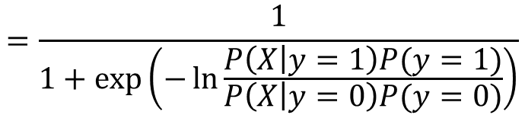
Logistic regression for classification
Why sigmoid function?
$P\left(y=1 | X\right)=\frac{P\left(X | y=1\right)P(y=1)}{P\left(X | y=1\right)P\left(y=1\right)+P\left(X | y=0\right)P(y=0)}$
$$=\frac{1}{1+\frac{P\left(X | y=0\right)P(y=0)}{P\left(X | y=1\right)P(y=1)}}$$
$$=\frac{1}{1+\exp\left(−\ln{\frac{P\left(X | y=1\right)P(y=1)}{P\left(X | y=0\right)P(y=0)}}\right)}$$

Slide 16
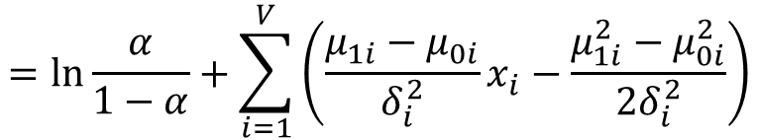




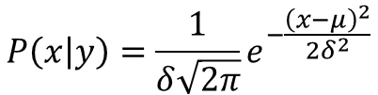
Logistic regression for classification
$$P\left(x | y\right)=\frac{1}{δ\sqrt{2π}}e^{−\frac{{\left(x−μ\right)}^{2}}{2δ^{2}}}$$
Why sigmoid function?
$\ln{\frac{P\left(X | y=1\right)P(y=1)}{P\left(X | y=0\right)P(y=0)}}=\ln{\frac{P(y=1)}{P(y=0)}}+\sum_{i=1}^{V}{\ln{\frac{P(x_{i}|y=1)}{P(x_{i}|y=0)}}}$
$$=\ln{\frac{α}{1−α}}+\sum_{i=1}^{V}{\left(\frac{μ_{1i}−μ_{0i}}{δ_{i}^{2}}x_{i}−\frac{μ_{1i}^{2}−μ_{0i}^{2}}{{2δ}_{i}^{2}}\right)}$$
$$=w_{0}+\sum_{i=1}^{V}{\frac{μ_{1i}−μ_{0i}}{δ_{i}^{2}}x_{i}}$$
Origin of the name: logit function
$$=w_{0}+w^{T}X$$
$$={\overline{w}}^{T}\overline{X}$$

Slide 17
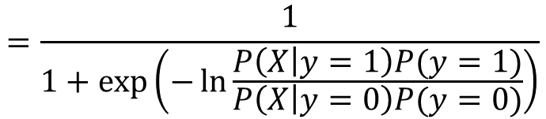
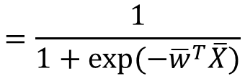
Logistic regression for classification
Why sigmoid function?
$P\left(y=1 | X\right)=\frac{P\left(X | y=1\right)P(y=1)}{P\left(X | y=1\right)P\left(y=1\right)+P\left(X | y=0\right)P(y=0)}$
$$=\frac{1}{1+\frac{P\left(X | y=0\right)P(y=0)}{P\left(X | y=1\right)P(y=1)}}$$
$$=\frac{1}{1+\exp\left(−\ln{\frac{P\left(X | y=1\right)P(y=1)}{P\left(X | y=0\right)P(y=0)}}\right)}$$
$$=\frac{1}{1+\exp{(−{\overline{w}}^{T}\overline{X})}}$$
Generalized Linear Model
Note: it is still a linear relation among the features!

Slide 18

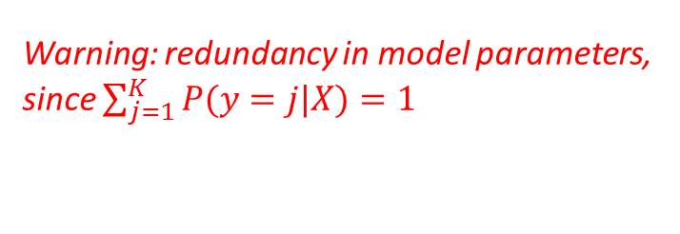


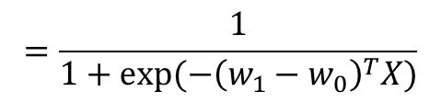

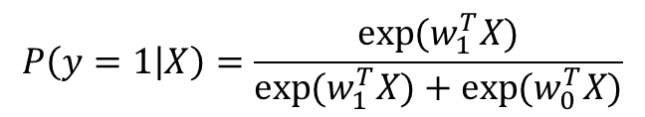
Logistic regression for classification
For multi-class categorization
$P\left(y=k | X\right)=\frac{\exp{(w_{k}^{T}X)}}{\sum_{j=1}^{K}{\exp{(w_{j}^{T}X)}}}$
$P\left(y=k | X\right)∝\exp{(w_{k}^{T}X)}$
y
x₁
x₂
x₃
…
x_{v}
Warning: redundancy in model parameters, since $\sum_{j=1}^{K}{P(y=j|X)}=1$
When $K$=2,
$$P\left(y=1 | X\right)=\frac{\exp{(w_{1}^{T}X)}}{\exp{(w_{1}^{T}X)}+\exp{(w_{0}^{T}X)}}$$
$$=\frac{1}{1+\exp{(−{\left(w_{1}−w_{0}\right)}^{T}X)}}$$
$$\overline{w}$$

Slide 19





Logistic regression for classification
Decision boundary for binary case
$\hat{y}=\left\{\begin{aligned}1, p\left(y=1 | X\right)>0.5 \\ 0, otherwise\end{aligned}\right.$
$\hat{y}=\left\{\begin{aligned}1, w^{T}x>0 \\ 0, otherwise\end{aligned}\right.$
$$p\left(y=1 | X\right)=\frac{1}{1+\exp{(−w^{T}X)}}>0.5$$
i.f.f.
$$\exp\left(−w^{T}X\right)<1$$
i.f.f.
$$w^{T}X>0$$
A linear model!

Slide 20



Logistic regression for classification
Decision boundary in general
$\hat{y}=argmax_{y}p\left(y | X\right)$
$$=argmax_{y}\exp{(w_{y}^{T}X)}$$
$$=argmax_{y}w_{y}^{T}X$$
A linear model!

Slide 21

Logistic regression for classification
Summary
$P\left(y=1 | X\right)=\frac{P\left(X | y=1\right)P(y=1)}{P\left(X | y=1\right)P\left(y=1\right)+P\left(X | y=0\right)P(y=0)}$
$$=\frac{1}{1+\frac{P\left(X | y=0\right)P(y=0)}{P\left(X | y=1\right)P(y=1)}}$$
Binomial
P(y|x)
$$P\left(y=1\right)=α$$
1.00
0.75
$$P\left(X | y=1\right)=N(μ_{1},δ^{2})$$
$$P\left(X | y=0\right)=N(μ_{0},δ^{2})$$
0.50
0.25
Normal with identical variance
0.00
x

Slide 22
Recap: Logistic regression for classification
Decision boundary for binary case
$\hat{y}=\left\{\begin{aligned}1, p\left(y=1 | X\right)>0.5 \\ 0, otherwise\end{aligned}\right.$
$\hat{y}=\left\{\begin{aligned}1, w^{T}x>0 \\ 0, otherwise\end{aligned}\right.$
$$p\left(y=1 | X\right)=\frac{1}{1+\exp{(−w^{T}X)}}>0.5$$
i.f.f.
$$\exp\left(−w^{T}X\right)<1$$
i.f.f.
$$w^{T}X>0$$
A linear model!

Slide 23
Recap: Logistic regression for classification
$$P\left(x | y\right)=\frac{1}{δ\sqrt{2π}}e^{−\frac{{\left(x−μ\right)}^{2}}{2δ^{2}}}$$
Why sigmoid function?
$\ln{\frac{P\left(X | y=1\right)P(y=1)}{P\left(X | y=0\right)P(y=0)}}=\ln{\frac{P(y=1)}{P(y=0)}}+\sum_{i=1}^{V}{\ln{\frac{P(x_{i}|y=1)}{P(x_{i}|y=0)}}}$
$$=\ln{\frac{α}{1−α}}+\sum_{i=1}^{V}{\left(\frac{μ_{1i}−μ_{0i}}{δ_{i}^{2}}x_{i}−\frac{μ_{1i}^{2}−μ_{0i}^{2}}{{2δ}_{i}^{2}}\right)}$$
$$=w_{0}+\sum_{i=1}^{V}{\frac{μ_{1i}−μ_{0i}}{δ_{i}^{2}}x_{i}}$$
Origin of the name: logit function
$$=w_{0}+w^{T}X$$
$$={\overline{w}}^{T}\overline{X}$$

Slide 24
Recap: parametric form of decision boundary in Naïve Bayes
For binary cases
$f\left(X\right)=sgn(\log{P\left(y=1 | X\right)−\log{P(y=0|X))}}$
$$=sgn\left(\log{\frac{P\left(y=1\right)}{P\left(y=0\right)}}+\sum_{i=1}^{\left|d\right|}{c\left(x_{i},d\right)\log{\frac{P\left(x_{i} | y=1\right)}{P\left(x_{i} | y=0\right)}}}\right)$$
$$=sgn(w^{T}\overline{X})$$
where
Linear regression?
$$w=\left(\log{\frac{P\left(y=1\right)}{P\left(y=0\right)}},\log{\frac{P\left(x_{1} | y=1\right)}{P\left(x_{1} | y=0\right)}},…,\log{\frac{P\left(x_{v} | y=1\right)}{P\left(x_{v} | y=0\right)}}\right)$$
$$\overline{X}=(1,c(x_{1},d),…,c(x_{v},d))$$

Slide 25

A different perspective
Imagine we have the following
Documents
Sentiment
“happy”, “good”, “purchase”, “item”, “indeed”
positive
$$p\left(x=\text{"}\text{happy}",y=1\right)+p\left(x=\text{"}\text{good}",y=1\right)+p\left(x="purchase",y=1\right)$$
$$+p\left(x=\text{"}\text{item}\text{"},y=1\right)+p\left(x="indeed",y=1\right)=1$$
Question: find a distribution $p(x,y)$ that satisfies this observation.
Answer1:
$p\left(x=\text{"}\text{item}\text{"},y=1\right)=1$, and all the others 0
Answer2:
$p\left(x=\text{"}\text{indeed}\text{"},y=1\right)=0.5$, $p\left(x=\text{"}\text{good}\text{"},y=1\right)=0.5$, and all the others 0
We have too little information to favor either one of them.

Slide 26
Occam's razor
A problem-solving principle
“among competing hypotheses that predict equally well, the one with the fewest assumptions should be selected.”
William of Ockham (1287–1347)
Principle of Insufficient Reason: "when one has no information to distinguish between the probability of two events, the best strategy is to consider them equally likely”
Pierre-Simon Laplace (1749–1827)

Slide 27

A different perspective
Imagine we have the following
Documents
Sentiment
“happy”, “good”, “purchase”, “item”, “indeed”
positive
$$p\left(x=\text{"}\text{happy}",y=1\right)+p\left(x=\text{"}\text{good}",y=1\right)+p\left(x="purchase",y=1\right)$$
$$+p\left(x=\text{"}\text{item}\text{"},y=1\right)+p\left(x="indeed",y=1\right)=1$$
Question: find a distribution $p(x,y)$ that satisfies this observation.
As a result, a safer choice would be:
$$p\left(x=\text{"}⋅\text{"},y=1\right)=0.2$$
Equally favor every possibility

Slide 28
A different perspective
Imagine we have the following
Observations
Sentiment
“happy”, “good”, “purchase”, “item”, “indeed”
positive
30% of time “good”, “item”
positive
$$p\left(x=\text{"}\text{happy}",y=1\right)+p\left(x=\text{"}\text{good}",y=1\right)+p\left(x="purchase",y=1\right)$$
$$+p\left(x=\text{"}\text{item}\text{"},y=1\right)+p\left(x="indeed",y=1\right)=1$$
$$p\left(x=\text{"}\text{good}",y=1\right)+p\left(x=\text{"}\text{item}\text{"},y=1\right)=0.3$$
Question: find a distribution $p(x,y)$ that satisfies this observation.
Again, a safer choice would be:
$p\left(x=\text{"}good\text{"},y=1\right)=p\left(x=\text{"}item\text{"},y=1\right)=0.15$,
and all the others $\frac{7}{30}$
Equally favor every possibility

Slide 29
A different perspective
Imagine we have the following
Observations
Sentiment
“happy”, “good”, “purchase”, “item”, “indeed”
positive
30% of time “good”, “item”
positive
50% of time “good”, “happy”
positive
$$p\left(x=\text{"}\text{happy}",y=1\right)+p\left(x=\text{"}\text{good}",y=1\right)+p\left(x="purchase",y=1\right)$$
$$+p\left(x=\text{"}\text{item}\text{"},y=1\right)+p\left(x="indeed",y=1\right)=1$$
$$p\left(x=\text{"}\text{good}",y=1\right)+p\left(x=\text{"}\text{item}\text{"},y=1\right)=0.3$$
$$p\left(x=\text{"}\text{good}",y=1\right)+p\left(x=\text{"}\text{happy}\text{"},y=1\right)=0.5$$
Question: find a distribution $p(x,y)$ that satisfies this observation.
Time to think about:
1) what do we mean by equally/uniformly favoring the models?
2) given all these constraints, how could we find the most preferred model?

Slide 30
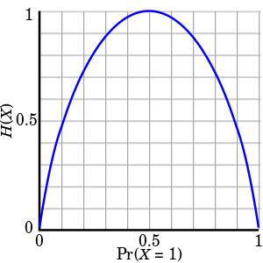


Maximum entropy modeling
A measure of uncertainty of random events
$H\left(X\right)=E\left[I\left(X\right)\right]=−\sum_{x∈X}{P\left(x\right)\log{P(x)}}$
Maximized when P(X) is a uniform distribution
Question 1 is answered, then how about question 2?

Slide 31
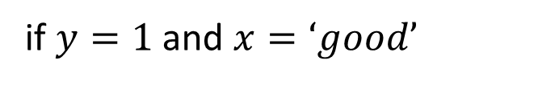
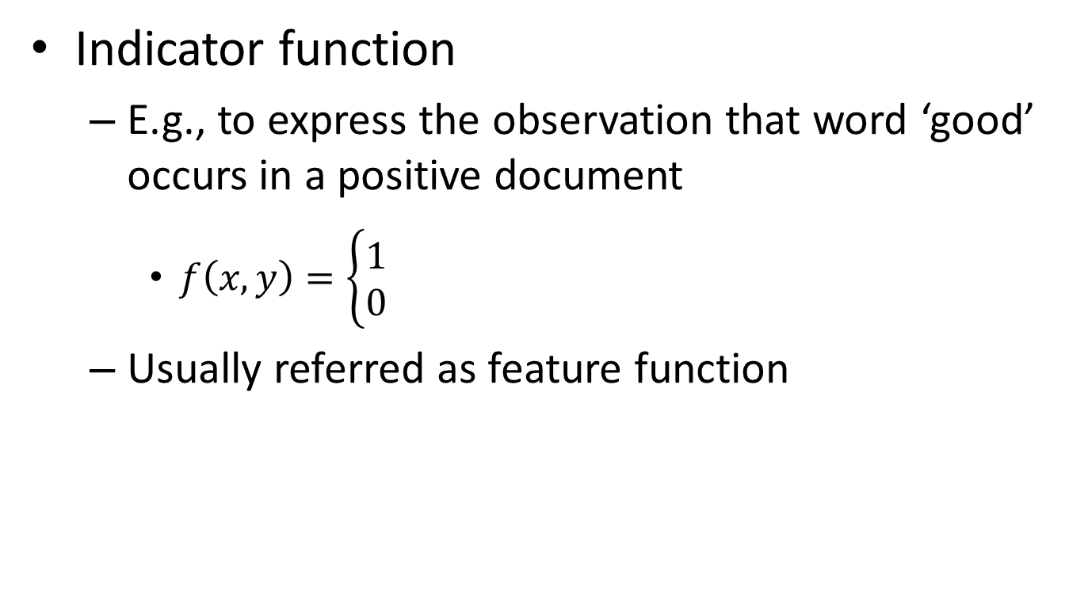
Represent the constraints
Indicator function
E.g., to express the observation that word ‘good’ occurs in a positive document
$f\left(x,y\right)=\left\{\begin{aligned}1 \\ 0\end{aligned}\right.$
Usually referred as feature function
if $y=1$ and $x=‘good’$
otherwise

Slide 32

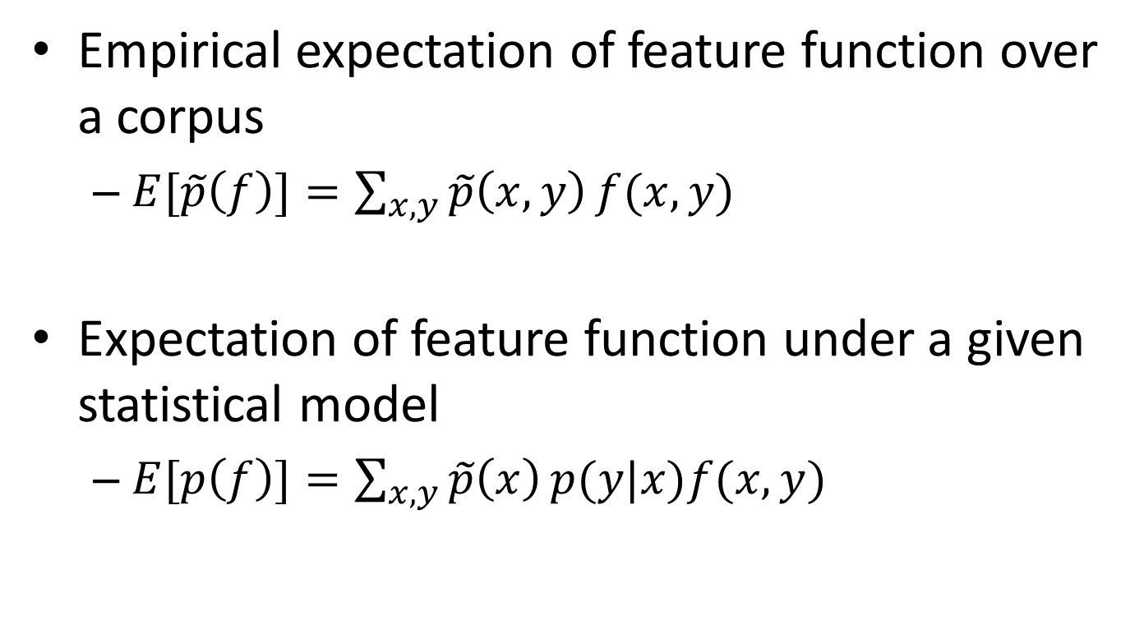
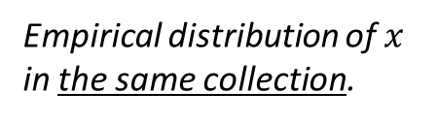
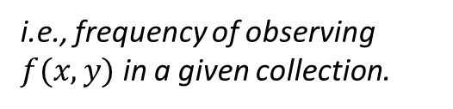
Represent the constraints
Empirical expectation of feature function over a corpus
$E[\tilde{p}\left(f\right)]=\sum_{x,y}{\tilde{p}\left(x,y\right)}f(x,y)$
Expectation of feature function under a given statistical model
$E[p\left(f\right)]=\sum_{x,y}{\tilde{p}\left(x\right)}p(y|x)f(x,y)$
where $\tilde{p}\left(x,y\right)=\frac{c(f(x,y))}{N}$
i.e., frequency of observing $f(x,y)$ in a given collection.
Empirical distribution of $x$ in the same collection.
Model’s estimation of conditional distribution.

Slide 33
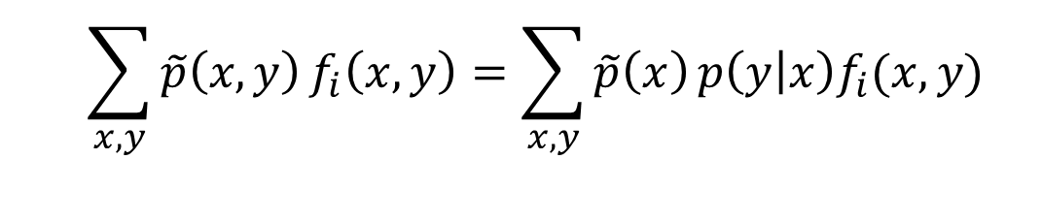

Represent the constraints
When a feature is important, we require our preferred statistical model to accord with it
$C≔\left\{p∈P|E[p\left(f_{i}\right)]=E[\tilde{p}\left(f_{i}\right)],∀i∈\{1,2,…,n\}\right\}$
$E[p\left(f_{i}\right)]=E[\tilde{p}\left(f_{i}\right)]$
$$\sum_{x,y}{\tilde{p}\left(x,y\right)}f_{i}\left(x,y\right)=\sum_{x,y}{\tilde{p}\left(x\right)}p\left(y | x\right)f_{i}(x,y)$$
We only need to specify this in our preferred model!
Is Question 2 answered?

Slide 34
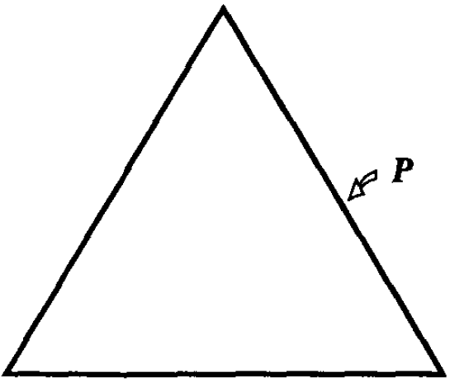
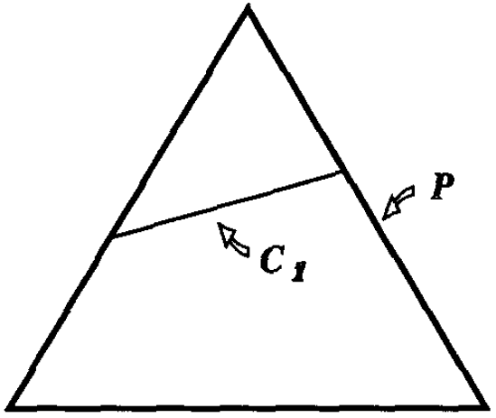
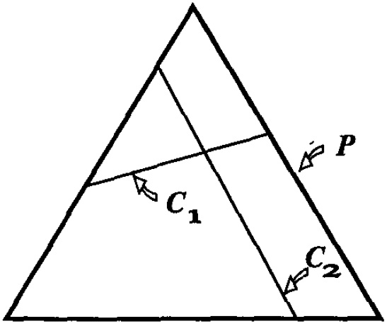
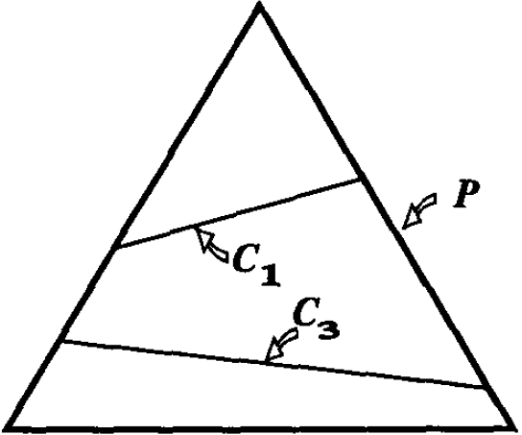
Represent the constraints
Let’s visualize this
(a) No constraint
(b) Under constrained
How to deal with these situations?
(c) Feasible constraint
(d) Over constrained

Slide 35




Maximum entropy principle
To select a model from a set $C$ of allowed probability distributions, choose the model $p^{∗}∈C$ with maximum entropy $H(p)$
$$p^{∗}=argmax_{p∈C}H(p)$$
$$p(y|x)$$
Both questions are answered!

Slide 36
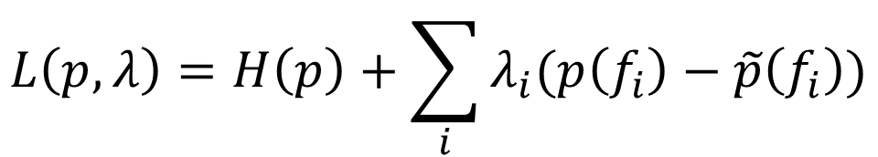

Maximum entropy principle
Let’s solve this constrained optimization problem with Lagrange multipliers
Primal:
$$p^{∗}=argmax_{p∈C}H(p)$$
a strategy for finding the local maxima and minima of a function subject to equality constraints
Lagrangian:
$$L\left(p,λ\right)=H\left(p\right)+\sum_{i}{λ_{i}(p\left(f_{i}\right)−\tilde{p}\left(f_{i}\right))}$$

Slide 37
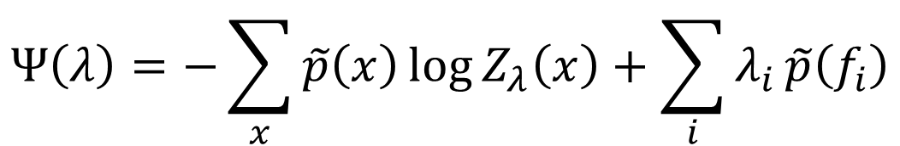
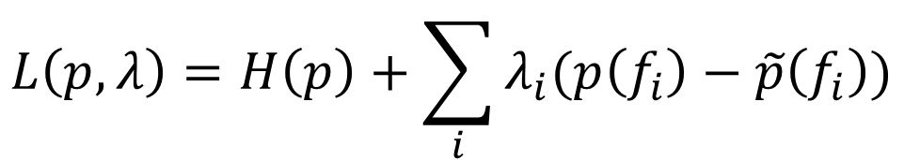
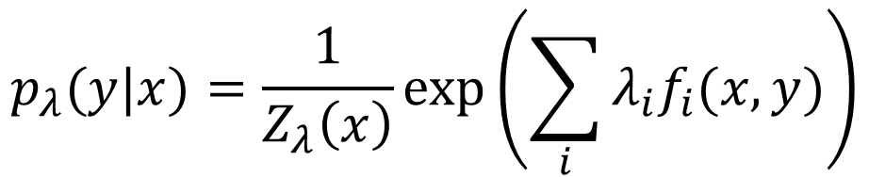
Maximum entropy principle
Let’s solve this constrained optimization problem with Lagrange multipliers
Lagrangian:
$$L\left(p,λ\right)=H\left(p\right)+\sum_{i}{λ_{i}(p\left(f_{i}\right)−\tilde{p}\left(f_{i}\right))}$$
Dual:
$$p_{λ}(y|x)=\frac{1}{Z_{λ}\left(x\right)}\exp\left(\sum_{i}{λ_{i}f_{i}(x,y)}\right)$$
$$Ψ\left(λ\right)=−\sum_{x}{\tilde{p}\left(x\right)\log{Z_{λ}\left(x\right)+\sum_{i}{λ_{i}}}}\tilde{p}\left(f_{i}\right)$$

Slide 38


Maximum entropy principle
Let’s solve this constrained optimization problem with Lagrange multipliers
Dual:
$$Ψ\left(λ\right)=−\sum_{x}{\tilde{p}\left(x\right)\log{Z_{λ}\left(x\right)+\sum_{i}{λ_{i}}}}\tilde{p}\left(f_{i}\right)$$
where
$$Z_{λ}=\sum_{y}{\exp\left(\sum_{i}{λ_{i}f_{i}(x,y)}\right)}$$

Slide 39


Maximum entropy principle
Let’s take a close look at the dual function
$$Ψ\left(λ\right)=−\sum_{x}{\tilde{p}\left(x\right)\log{Z_{λ}\left(x\right)+\sum_{i}{λ_{i}}}}\tilde{p}\left(f_{i}\right)$$
where
$$Z_{λ}=\sum_{y}{\exp\left(\sum_{i}{λ_{i}f_{i}(x,y)}\right)}$$

Slide 40



Maximum entropy principle
Let’s take a close look at the dual function
$$Ψ\left(λ\right)=−\sum_{x}{\tilde{p}\left(x\right)\log{Z_{λ}\left(x\right)+}}\sum_{x}{\tilde{p}\left(x\right)\sum_{i}{λ_{i}\tilde{p}\left(f_{i}\right)}}$$
$$=\sum_{x}{\tilde{p}\left(x\right)}\log{\frac{\exp{(\sum_{i}{λ_{i}\tilde{p}\left(f_{i}\right)})}}{Z_{λ}\left(x\right)}}$$
$$=\sum_{x}{\tilde{p}\left(x\right)}\log{p(y|x)}$$
Maximum likelihood estimator!

Slide 41



Maximum entropy principle
Primal: maximum entropy
$p^{∗}=argmax_{p∈C}H(p)$
Dual: logistic regression
$p_{λ}(y|x)=\frac{1}{Z_{λ}\left(x\right)}\exp\left(\sum_{i}{λ_{i}f_{i}(x,y)}\right)$
$$Z_{λ}=\sum_{y}{\exp\left(\sum_{i}{λ_{i}f_{i}(x,y)}\right)}$$
where
$λ^{∗}$ is determined by $Ψ(λ)$

Slide 42

Questions haven’t been answered
Class conditional density
Why it should be Gaussian with equal variance?
Model parameters
What is the relationship between $w$ and $λ$?
How to estimate them?

Slide 43
Recap: Occam's razor
A problem-solving principle
“among competing hypotheses that predict equally well, the one with the fewest assumptions should be selected.”
William of Ockham (1287–1347)
Principle of Insufficient Reason: "when one has no information to distinguish between the probability of two events, the best strategy is to consider them equally likely”
Pierre-Simon Laplace (1749–1827)

Slide 44
Recap: a different perspective
Imagine we have the following
Observations
Sentiment
“happy”, “good”, “purchase”, “item”, “indeed”
positive
30% of time “good”, “item”
positive
50% of time “good”, “happy”
positive
$$p\left(x=\text{"}\text{happy}",y=1\right)+p\left(x=\text{"}\text{good}",y=1\right)+p\left(x="purchase",y=1\right)$$
$$+p\left(x=\text{"}\text{item}\text{"},y=1\right)+p\left(x="indeed",y=1\right)=1$$
$$p\left(x=\text{"}\text{good}",y=1\right)+p\left(x=\text{"}\text{item}\text{"},y=1\right)=0.3$$
$$p\left(x=\text{"}\text{good}",y=1\right)+p\left(x=\text{"}\text{happy}\text{"},y=1\right)=0.5$$
Question: find a distribution $p(x,y)$ that satisfies this observation.
Time to think about:
1) what do we mean by equally/uniformly favoring the models?
2) given all these constraints, how could we find the most preferred model?

Slide 45
Recap: maximum entropy modeling
A measure of uncertainty of random events
$H\left(X\right)=E\left[I\left(X\right)\right]=−\sum_{x∈X}{P\left(x\right)\log{P(x)}}$
Maximized when P(X) is a uniform distribution
Question 1 is answered, then how about question 2?

Slide 46
Recap: represent the constraints
Empirical expectation of feature function over a corpus
$E[\tilde{p}\left(f\right)]=\sum_{x,y}{\tilde{p}\left(x,y\right)}f(x,y)$
Expectation of feature function under a given statistical model
$E[p\left(f\right)]=\sum_{x,y}{\tilde{p}\left(x\right)}p(y|x)f(x,y)$
where $\tilde{p}\left(x,y\right)=\frac{c(f(x,y))}{N}$
i.e., frequency of observing $f(x,y)$ in a given collection.
Empirical distribution of $x$ in the same collection.
Model’s estimation of conditional distribution.

Slide 47
Recap: maximum entropy principle
Let’s solve this constrained optimization problem with Lagrange multipliers
Primal:
$$p^{∗}=argmax_{p∈C}H(p)$$
a strategy for finding the local maxima and minima of a function subject to equality constraints
Lagrangian:
$$L\left(p,λ\right)=H\left(p\right)+\sum_{i}{λ_{i}(p\left(f_{i}\right)−\tilde{p}\left(f_{i}\right))}$$

Slide 48
Recap: maximum entropy principle
Let’s take a close look at the dual function
$$Ψ\left(λ\right)=−\sum_{x}{\tilde{p}\left(x\right)\log{Z_{λ}\left(x\right)+}}\sum_{x}{\tilde{p}\left(x\right)\sum_{i}{λ_{i}\tilde{p}\left(f_{i}\right)}}$$
$$=\sum_{x}{\tilde{p}\left(x\right)}\log{\frac{\exp{(\sum_{i}{λ_{i}\tilde{p}\left(f_{i}\right)})}}{Z_{λ}\left(x\right)}}$$
$$=\sum_{x}{\tilde{p}\left(x\right)}\log{p(y|x)}$$
Maximum likelihood estimator!

Slide 49


Maximum entropy principle
The maximum entropy model subject to the constraints $C$ has a parametric solution $p_{λ}^{∗}(y|x)$ where the parameters $λ^{∗}$ can be determined by maximizing the likelihood function of $p_{λ}(y|x)$ over a training set
With a Gaussian distribution, differential entropy is maximized for a given variance.
Features follow Gaussian distribution
Maximum entropy model
Logistic regression

Slide 50


Parameter estimation
Maximum likelihood estimation
$L\left(w\right)=\sum_{d∈D}{y_{d}\log{p(y_{d}=1|X_{d})}+(1−y_{d})\log{p(y_{d}=0|X_{d})}}$
Take gradient of $L\left(w\right)$ with respect to $w$
$$\frac{∂L\left(w\right)}{∂w}=\sum_{d∈D}{y_{d}\frac{∂\log{p(y_{d}=1|X_{d})}}{∂w}+(1−y_{d})\frac{∂\log{p(y_{d}=0|X_{d})}}{∂w}}$$

Slide 51



Parameter estimation
Maximum likelihood estimation
$\frac{∂\log{p(y_{d}=1|X_{d})}}{∂w}=−\frac{∂\log\left(1+exp⁡(−w^{T}X_{d})\right)}{∂w}$
$\frac{∂\log{p(y_{d}=0|X_{d})}}{∂w}=\left(0−p(y_{d}=1|X_{d})\right)X_{d}$
$$=\frac{exp⁡(−w^{T}X_{d})}{1+exp⁡(−w^{T}X_{d})}X_{d}$$
$$=\left(1−p(y_{d}=1|X_{d})\right)X_{d}$$

Slide 52



Parameter estimation
Maximum likelihood estimation
$L\left(w\right)=\sum_{d∈D}{y_{d}\log{p(y_{d}=1|X_{d})}+(1−y_{d})\log{p(y_{d}=0|X_{d})}}$
Take gradient of $L\left(w\right)$ with respect to $w$
$$\frac{∂L\left(w\right)}{∂w}=\sum_{d∈D}{y_{d}\frac{∂\log{p(y_{d}=1|X_{d})}}{∂w}+(1−y_{d})\frac{∂\log{p(y_{d}=0|X_{d})}}{∂w}}$$
$$=\sum_{d∈D}{y_{d}\left(1−p\left(y_{d}=1 | X_{d}\right)\right)X_{d}+\left(1−y_{d}\right)\left(0−p\left(y_{d}=1 | X_{d}\right)\right)X_{d}}$$
Good news: neat format, concave function for $w$
$$=\sum_{d∈D}{\left(y_{d}−p\left(y=1 | X_{d}\right)\right)X_{d}}$$
Bad news: no close form solution
Can be easily generalized to multi-class case

Slide 53



Gradient-based optimization
Gradient descent
$∇L\left(w\right)=[\frac{∂L\left(w\right)}{∂w_{0}},\frac{∂L\left(w\right)}{∂w_{1}},…,\frac{∂L\left(w\right)}{∂w_{V}}]$
$w^{(t+1)}=w^{(t)}−η^{(t)}∇L\left(w\right)$
Iterative updating
Step-size, affects convergence

Slide 54





Parameter estimation
Stochastic gradient descent
while not converge
randomly choose $d∈D$
$$∇L_{d}\left(w\right)=[\frac{∂L_{d}\left(w\right)}{∂w_{0}},\frac{∂L_{d}\left(w\right)}{∂w_{1}},…,\frac{∂L_{d}\left(w\right)}{∂w_{V}}]$$
$$w^{(t+1)}=w^{(t)}−η^{\left(t\right)}∇L_{d}\left(w\right)$$
$$η^{(t+1)}=aη^{\left(t\right)}$$
Gradually shrink the step-size

Slide 55




Parameter estimation
Batch gradient descent
while not converge
Compute gradient w.r.t. all training instances
Compute step size $η^{\left(t\right)}$
$$∇L_{D}\left(w\right)=[\frac{∂L_{D}\left(w\right)}{∂w_{0}},\frac{∂L_{D}\left(w\right)}{∂w_{1}},…,\frac{∂L_{D}\left(w\right)}{∂w_{V}}]$$
Line search is required to ensure sufficient decent
$$w^{(t+1)}=w^{(t)}−η^{\left(t\right)}∇L_{d}\left(w\right)$$
First order method
Second order methods, e.g., quasi-Newton method and conjugate gradient, provide faster convergence

Slide 56
Model regularization
Avoid over-fitting
We may not have enough samples to well estimate model parameters for logistic regression
Regularization
Impose additional constraints over the model parameters
E.g., sparsity constraint – enforce the model to have more zero parameters

Slide 57



Model regularization
L2 regularized logistic regression
Assume the model parameter $w$ is drawn from Gaussian: $w∼N(0,σ^{2})$
$p\left(y_{d},w | X_{d}\right)∝p\left(y_{d} | X_{d},w\right)p(w)$
$L\left(w\right)=\sum_{d∈D}{[y_{d}\log{p(y_{d}=1|X_{d})}}$
$$+(1−y_{d})\log{p\left(y_{d}=0 | X_{d}\right)}]−\frac{w^{T}w}{2σ^{2}}$$
L2-norm of $w$

Slide 58


Generative V.S. Discriminative models
Generative
Discriminative
Specifying joint distribution
Full probabilistic specification for all the random variables
Dependence assumption has to be specified for $p\left(X | y\right)$ and $p(y)$
Flexible, can be used in unsupervised learning
Specifying conditional distribution
Only explain the target variable
Arbitrary features can be incorporated for modeling $p\left(y | X\right)$
Need labeled data, only suitable for (semi-) supervised learning

Slide 59


Naïve Bayes V.S. Logistic regression
Naive Bayes
Logistic Regression
Conditional independence
$p\left(X | y\right)=\prod_{i}{p(x_{i}|y)}$
Distribution assumption of $p(x_{i}|y)$
# parameters
$k(V+1)$
Model estimation
Closed form MLE
Asymptotic convergence rate
$ε_{NB,n}≤ε_{NB,∞}+O(\sqrt{\frac{\log{V}}{n}})$
No independence assumption
Functional form assumption of $p\left(y | X\right)∝\exp{(w_{y}^{T}X)}$
# parameters
$(k−1)(V+1)$
Model estimation
Gradient-based MLE
Asymptotic convergence rate
$ε_{LR,n}≤ε_{LR,∞}+O(\sqrt{\frac{V}{n}})$
Need more training data

Slide 60


Naïve Bayes V.S. Logistic regression
LR
NB
"On discriminative vs. generative classifiers: A comparison of logistic regression and naive bayes.“ – Ng, Jordan NIPS 2002, UCI Data set

